Slide 1
Probability Distribution (2)
Md. Ismail Hossain Riday

Slide 2
Probability Distribution
Distribution of the probabilities among the different values of a random variable.

Slide 3
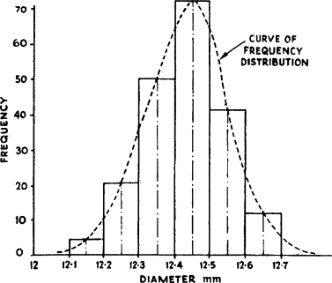
Probability Distribution
Probability Distribution

Slide 4
Probability Distribution
Probability Distribution
Discrete
Continuous

Slide 5
Probability Distribution
Discrete PD
Binomial Distribution
Poisson Distribution
Geometric Distribution
Continuous PD
Uniform Distribution
Normal Distribution
Exponential Distribution

Slide 6

Binomial Distribution
First we need to learn about Bernoulli trial.
Suppose an experiment has only two outcomes
Success
Failure
$$X=\left\{\begin{aligned}1;if succsess occurs \\ 0;if failure occurs \end{aligned}\right.$$
Bernoulli variable

Slide 7
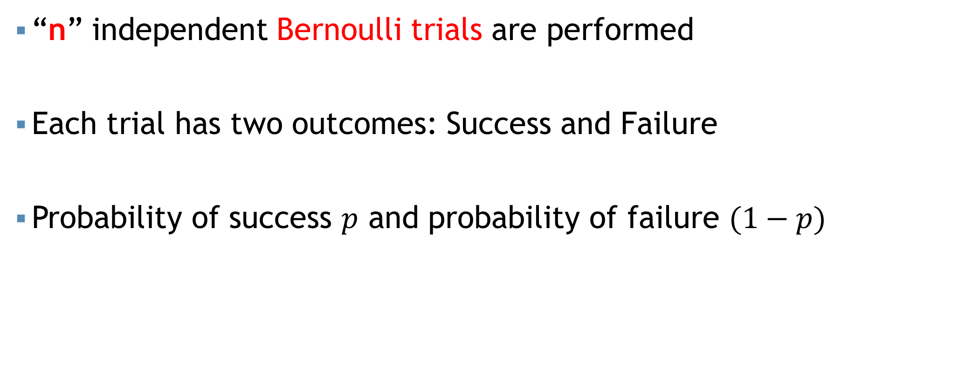
Binomial Distribution
“n” independent Bernoulli trials are performed
Each trial has two outcomes: Success and Failure
Probability of success $p$ and probability of failure $(1−p)$

Slide 8

Binomial Distribution
Probability mass function of binomial distribution,
$$p\left(x\right)={}_{}^{n}{C_{x}{ p}^{x} {\left(1−p\right)}^{n−x}};x=0,1,2,3,…,n$$
$$X\sim binomial \left(n,p\right)$$
“n” and “p” are Parameter

Slide 9
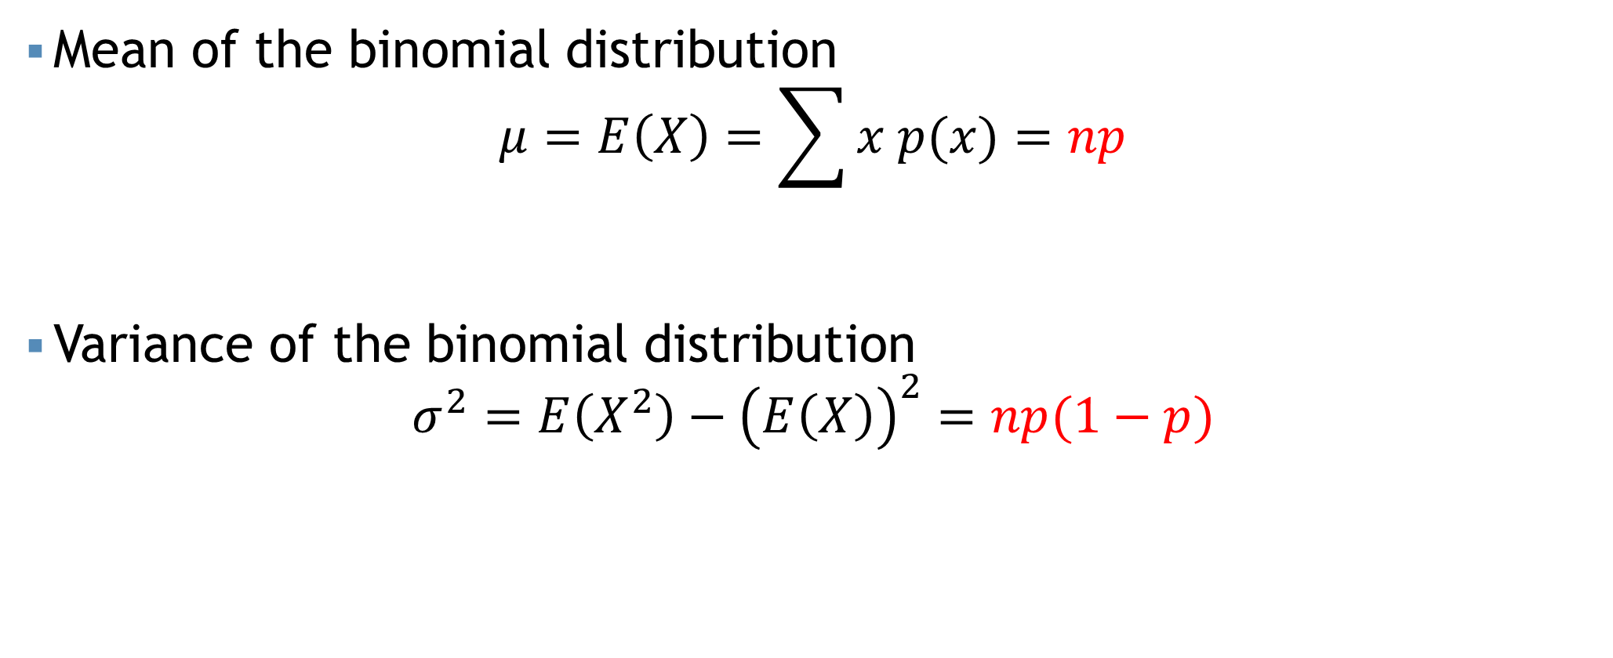
Binomial Distribution
Mean of the binomial distribution
$$μ=E\left(X\right)=\sum{x p(x)}=np$$
Variance of the binomial distribution
$$σ^{2}=E\left(X^{2}\right)−{\left(E\left(X\right)\right)}^{2}=np(1−p)$$

Slide 10
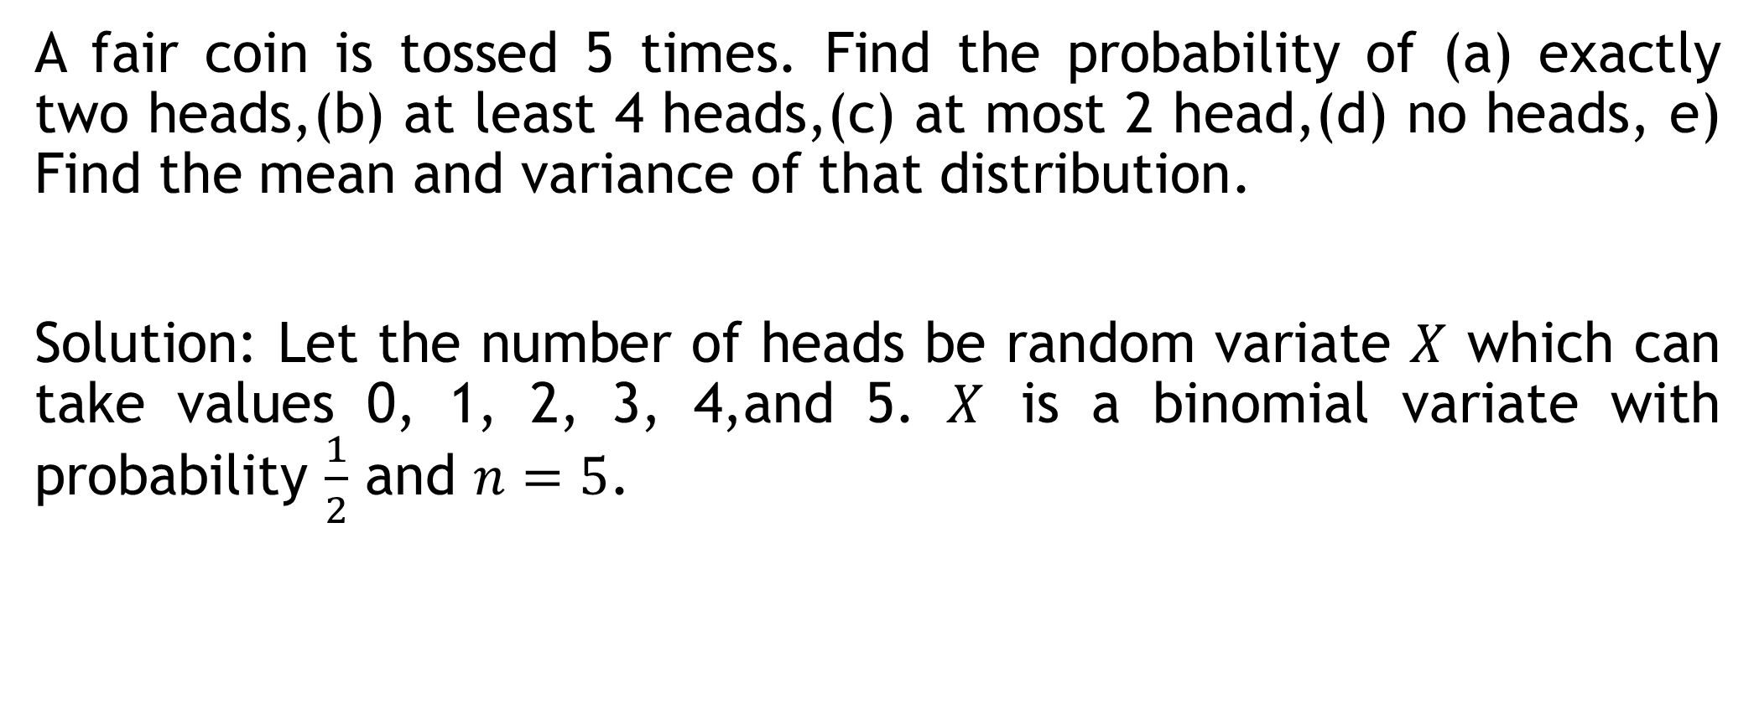
Binomial Distribution
A fair coin is tossed 5 times. Find the probability of (a) exactly two heads,(b) at least 4 heads,(c) at most 2 head,(d) no heads, e) Find the mean and variance of that distribution.
Solution: Let the number of heads be random variate $X$ which can take values 0, 1, 2, 3, 4,and 5. $X$ is a binomial variate with probability $\frac{1}{2}$ and $n=5$.

Slide 11
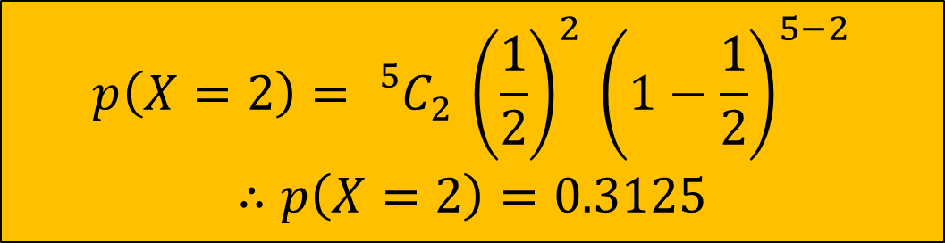

Binomial Distribution
(a) exactly two heads
(b) at least 4 heads
$$p\left(x\right)={}_{}^{n}{C_{x}{ p}^{x} {\left(1−p\right)}^{n−x}}$$
$$p\left(x\right)={}_{}^{n}{C_{x}{ p}^{x} {\left(1−p\right)}^{n−x}}$$
$$p\left(X=2\right)={}_{}^{5}{C_{2}{ \left(\frac{1}{2}\right)}^{2} {\left(1−\frac{1}{2}\right)}^{5−2}}$$
$$∴p\left(X=2\right)=0.3125$$
$$p\left(X≥4\right)=P\left(X=4\right)+P(X=5)$$
$$∴p\left(X=4\right)={}_{}^{5}{C_{4}{ \left(\frac{1}{2}\right)}^{4} {\left(1−\frac{1}{2}\right)}^{5−4}}$$
$$∴p\left(X=5\right)={}_{}^{5}{C_{5}{ \left(\frac{1}{2}\right)}^{5} {\left(1−\frac{1}{2}\right)}^{5−5}}$$
$$∴P\left(X=4\right)+P\left(X=5\right)=0.1875$$

Slide 12
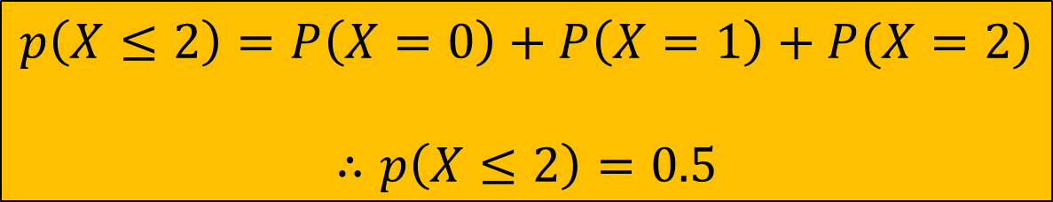
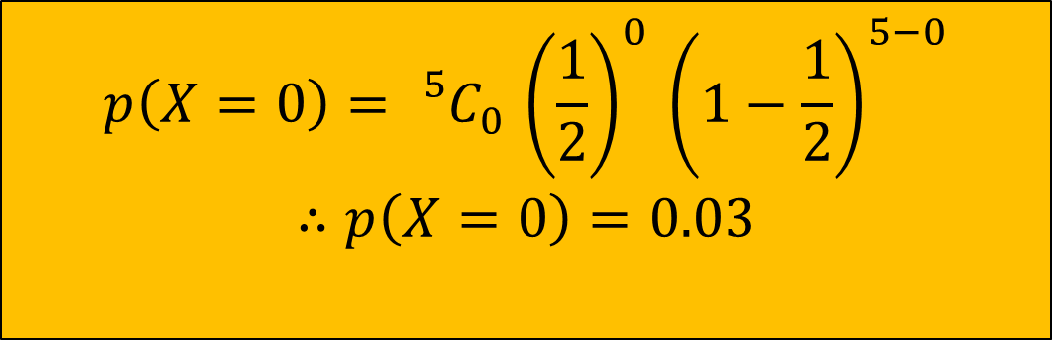
Binomial Distribution
(c) at most 2 head
(d) no heads
$$p\left(x\right)={}_{}^{n}{C_{x}{ p}^{x} {\left(1−p\right)}^{n−x}}$$
$$p\left(x\right)={}_{}^{n}{C_{x}{ p}^{x} {\left(1−p\right)}^{n−x}}$$
$$p\left(X≤2\right)=P\left(X=0\right)+P\left(X=1\right)+P(X=2)$$
$$∴p\left(X≤2\right)=0.5$$
$$p\left(X=0\right)={}_{}^{5}{C_{0}{ \left(\frac{1}{2}\right)}^{0} {\left(1−\frac{1}{2}\right)}^{5−0}}$$
$$∴p\left(X=0\right)=0.03$$

Slide 13



Binomial Distribution
$Mean=np=5×\frac{1}{2}=2.5$
$Variance=np\left(1−p\right)=5×\frac{1}{2}×\frac{1}{2}=1.25$
$$Mean=np$$
$$Variance=np(1−p)$$

Slide 14
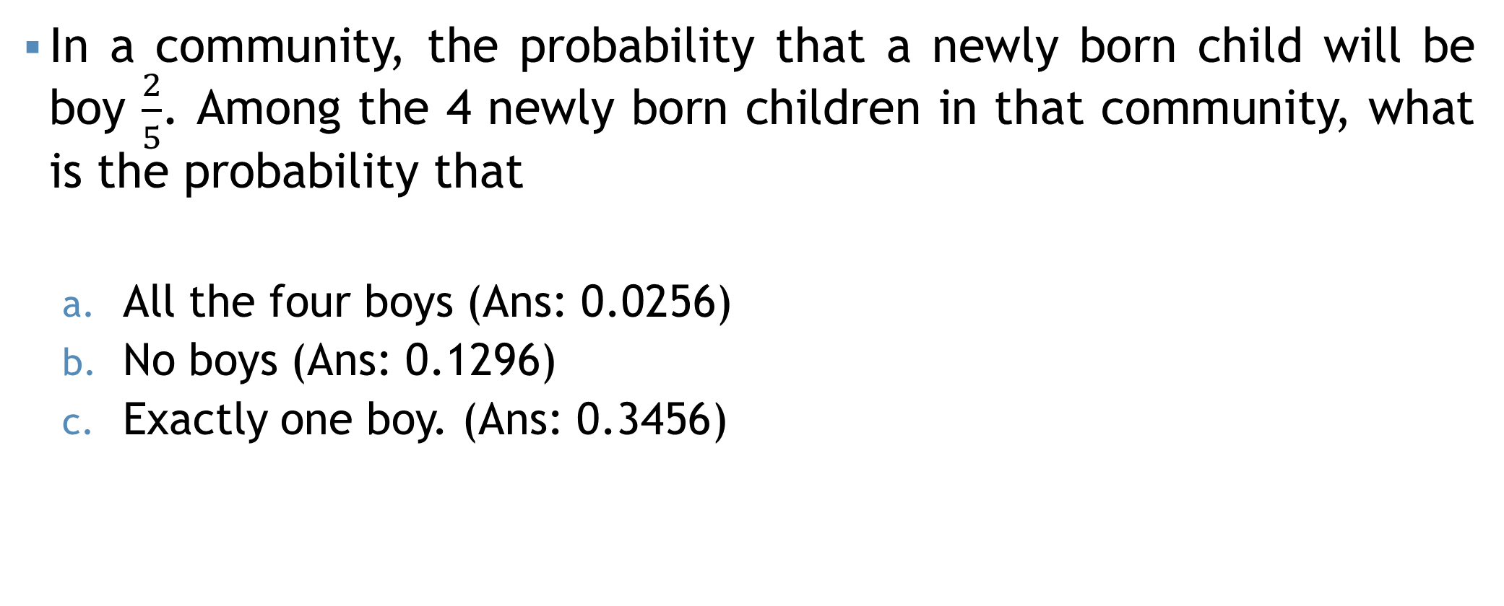
Binomial Distribution
In a community, the probability that a newly born child will be boy $\frac{2}{5}$. Among the 4 newly born children in that community, what is the probability that
All the four boys (Ans: 0.0256)
No boys (Ans: 0.1296)
Exactly one boy. (Ans: 0.3456)

Slide 15
Binomial Distribution
The incidence of occupational disease in an industry is such that the workers have a 20% chance of suffering from it. What is the probability that out of 6 workers
4 or more will contract disease (Ans: 0.01696)
exactly 2 workers will contract disease? (Ans:0.24576)

Slide 16
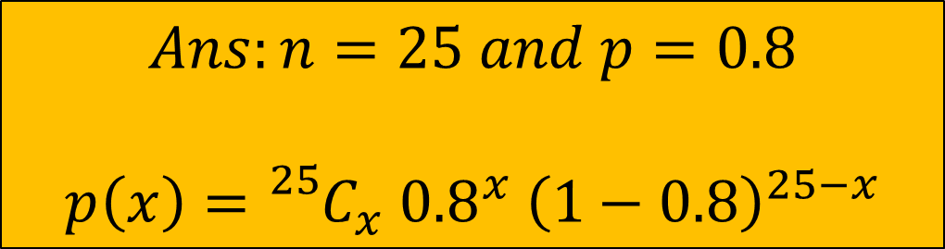
Binomial Distribution
The mean and standard deviation of binomial variable are 20 and 2, respectively. Find the parameters and probability function of the distribution.
$$Ans:n=25 and p=0.8$$
$$p\left(x\right)={}_{}^{25}{C_{x}{ 0.8}^{x} {\left(1−0.8\right)}^{25−x}}$$

Slide 17
Poisson Distribution
When data represents the number of occurrence of a specific event in a fixed period of time.

Slide 18
Poisson Distribution
When data represents the number of occurrence of a specific event in a fixed period of time.

Slide 19
Poisson Distribution
When data represents the number of occurrence of a specific event in a fixed period of time.

Slide 20

Poisson Distribution
Binomial dist. describe the distribution of binary data from finite sample
When data represents the number of occurrence of a specific event in a fixed period of time.
For example,
“The number of cars arrived at a toll gate per minute”
“The number of traffic accidents during a given time day”
Poisson dist. describe the distribution of binary data from infinite sample $\left(n≥100\right)$

Slide 21



Poisson Distribution
The probability mass function of Poisson distribution:
$$P\left(x\right)=\frac{e^{−λ}λ^{x}}{x!};x=0,1,2,…$$
$$X\sim Poisson (λ)$$
$$λ=np$$
$$Mean, E\left(X\right)=λ=np$$
$$Variance, Var\left(X\right)=λ=np$$
Parameter of Poisson dist.

Slide 22
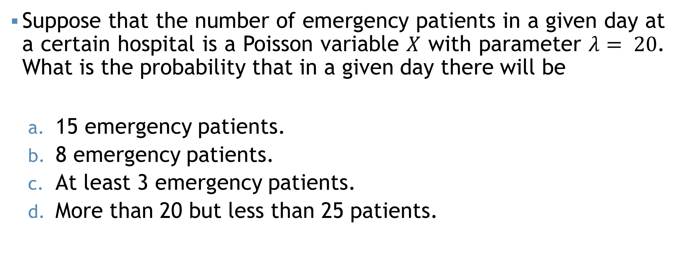
Poisson Distribution
Suppose that the number of emergency patients in a given day at a certain hospital is a Poisson variable $X$ with parameter $λ= 20$. What is the probability that in a given day there will be
15 emergency patients.
8 emergency patients.
At least 3 emergency patients.
More than 20 but less than 25 patients.

Slide 23
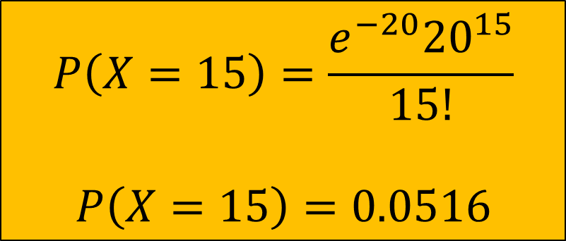
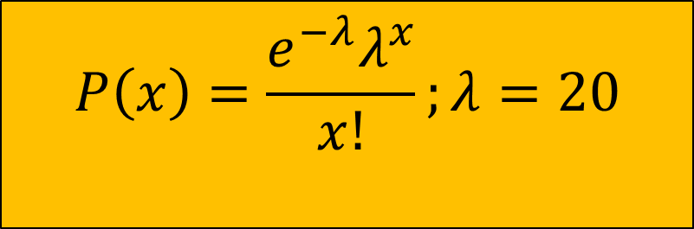
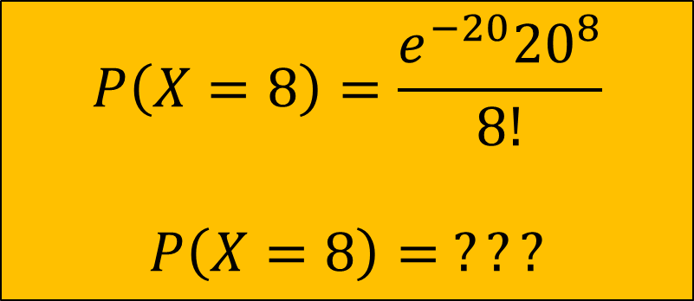
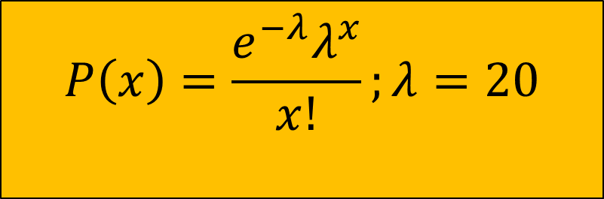
Poisson Distribution
a) 15 emergency patients
b) 8 emergency patients
$$P\left(x\right)=\frac{e^{−λ}λ^{x}}{x!};λ=20$$
$$P\left(x\right)=\frac{e^{−λ}λ^{x}}{x!};λ=20$$
$$P\left(X=15\right)=\frac{e^{−20}{20}^{15}}{15!}$$
$$P\left(X=15\right)=0.0516$$
$$P\left(X=8\right)=\frac{e^{−20}{20}^{8}}{8!}$$
$$P\left(X=8\right)= ???$$

Slide 24
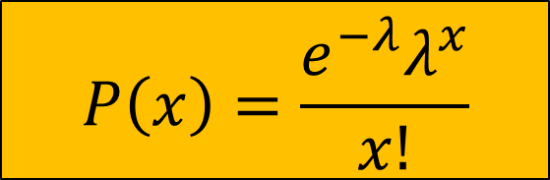




Poisson Distribution
c) At least 3 patients
$$λ=20$$
$$P\left(X≥3\right)$$
$$P\left(X≥3\right)=1−P(X<3)$$
$$P\left(X≥3\right)=1$$
$$P\left(X=0\right)+P\left(X=1\right)+P(X=2)$$
$$P\left(x\right)=\frac{e^{−λ}λ^{x}}{x!}$$

Slide 25




Poisson Distribution
c) $>$20 but $<$25 patients
$$λ=20$$
$$P\left(20<X<25\right)$$
$$P\left(20<X<25\right)=0.2841$$
$$P\left(X=21\right)+P\left(X=22\right)+P\left(X=23\right)+P(X=24)$$
$$P\left(x\right)=\frac{e^{−λ}λ^{x}}{x!}$$

Slide 26
Poisson Distribution
The average number of errors on a page of a certain magazine is 0.2. What is the probability that the next page (or a randomly selected page) you read contains
0 (zero) error? (Ans: 0.8187)
2 or more errors? (Ans: 0.01756)
What is the average error per page? (Ans: 0.2)
Also, find standard deviation of the number of errors. (Ans: 0.45)

Slide 27



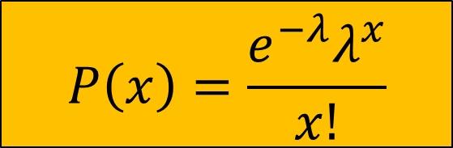

Poisson Distribution
$$P\left(x\right)=\frac{e^{−λ}λ^{x}}{x!}$$
Imagine you're employed as a transportation engineer, tasked with assessing the likelihood of vehicular accidents. On a highly trafficked segment of road, the probability of a single car accident occurring per hour is 0.001. If 2000 cars traverse this stretch of road in one hour, what is the probability that precisely three car accidents will occur on this road within that time frame? (Ans: 0.180)
$$P\left(X=3\right)$$
$$p=0.001$$
$$n=2000$$
$$np=λ=2000×0.001$$

Slide 28
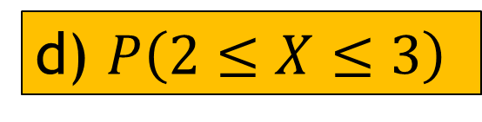

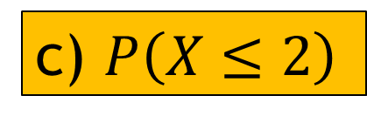
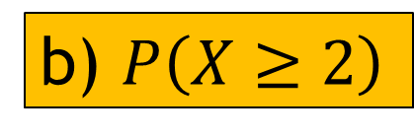
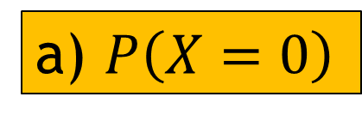
Poisson Distribution
$$λ=3$$
A telephone operator receives 3 telephone calls on average from 9AM to 10AM. Find the probability that in a given time interval of a day, the operator receives,
No call
At least two calls
At best two calls (At most two calls)
Two or three calls
a) $P\left(X=0\right)$
b) $P\left(X≥2\right)$
c) $P\left(X≤2\right)$
d) $P\left(2≤X≤3\right)$
$$P\left(x\right)=\frac{e^{−λ}λ^{x}}{x!}$$

Slide 29
Geometric Distribution
When we want to know how many how many trials required before achieving the first success in repeated Bernoulli trials, we may used geometric probability distribution.

Slide 30
Geometric Distribution
Toss a coin and the event is “Head”
First trial = Tail
Second trial = Tail
Third trial = Tail
Fourth trial = Head

Slide 31








Geometric Distribution
Toss a coin and the event is “Head”
First trial = Tail
Second trial = Tail
Third trial = Tail
Fourth trial = Head
$$(1−P)$$
$$P{\left(1−P\right)}^{4−1}$$
$$(1−P)$$
$$P{\left(1−P\right)}^{5−1}$$
$$(1−P)$$
$$P{\left(1−P\right)}^{6−1}$$
$$P$$
$$P{\left(1−P\right)}^{x−1}$$

Slide 32

Geometric Distribution
The probability mass function for geometric distribution
$$p\left(x\right)=p{\left(1−p\right)}^{x−1} ;x=1,2,…$$
$Mean=\frac{1}{p}$
$Variance=\frac{1−p}{p^{2}}$

Slide 33
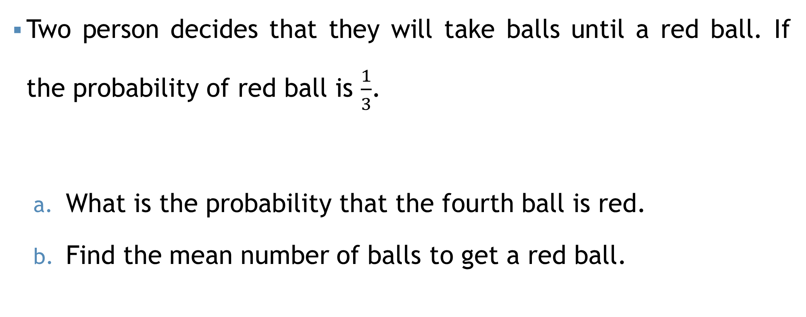
Geometric Distribution
Two person decides that they will take balls until a red ball. If the probability of red ball is $\frac{1}{3}$.
What is the probability that the fourth ball is red.
Find the mean number of balls to get a red ball.

Slide 34

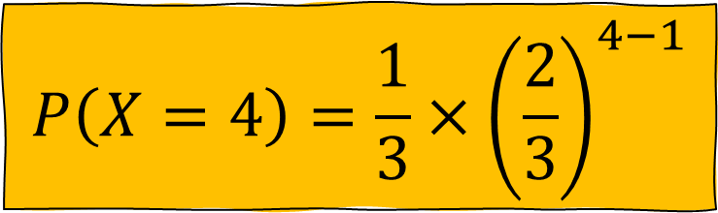
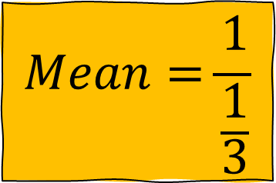

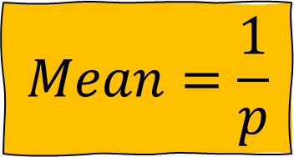

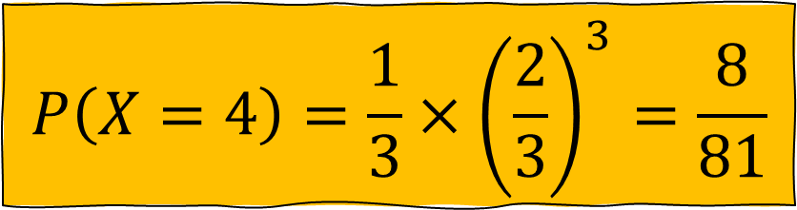
Geometric Distribution
$$P\left(X=4\right)=\frac{1}{3}×{\left(\frac{2}{3}\right)}^{4−1}$$
$$P\left(X=4\right)=\frac{1}{3}×{\left(\frac{2}{3}\right)}^{3}=\frac{8}{81}$$
$$P(X=4)$$
$$Mean=\frac{1}{p}$$
$$Mean=\frac{1}{\frac{1}{3}}$$
$$Mean$$
$$Mean=3$$

Slide 35
Self Practice
A biologist estimates that the chance of germination for a type of bean seed is 0.5%. A student was given 120 seeds. Assuming that the germination of seeds is independent, find the probabilities,
At least three seeds are germinated.
Suppose 6 students have conducted the experiment independently, then what is the probability that 3 students will get at most three seeds germinated?

Slide 36
Mathematical exercise
To access additional mathematical problems, please refer to the PDF lecture notes.

Slide 37
Thank You

